Slide 1


Name: Pavan S Kulkarni
Enrollment number: EBEON0123686200

Slide 2
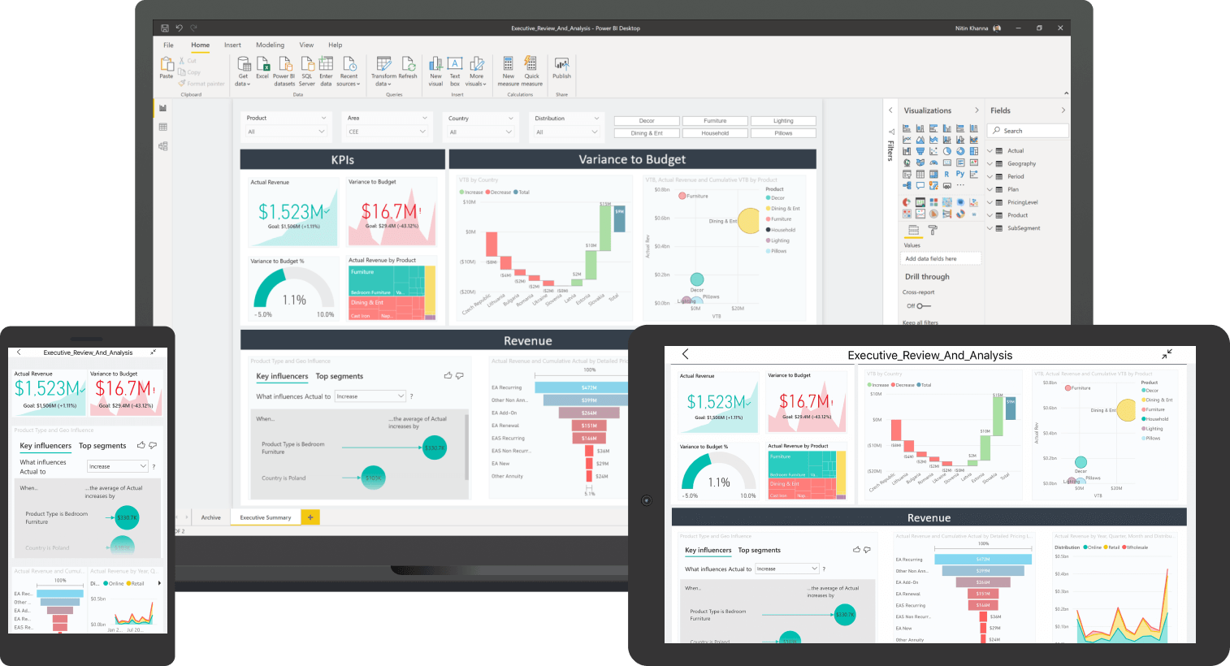
Power BI
Microsoft Power BI is a business intelligence (BI) platform that provides nontechnical business users with tools for aggregating, analyzing, visualizing and sharing data.
For the project we are using Global Superstore Data.

Slide 3
Process of making power bi dashboard
Select the data set you want to represent visually.
Select the data sources.
Create a data model.
Establish relationships between tables.
Visualize the data.
Design the dashboard.

Slide 4
Tools Used IN POWER BI
SLICER
BAR CHART
LINE CHART
CARD
FILLED MAP / DONUT CHART
KPI

Slide 5
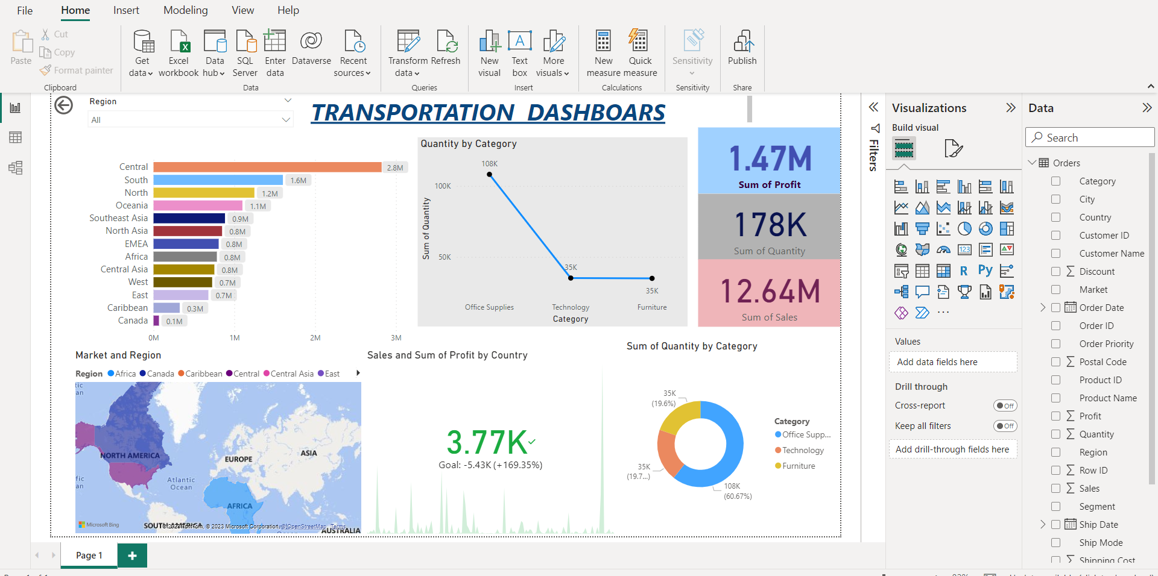
PowerBI Dashboards

Slide 6

Tableau
Tableau is a visual analytics platform transforming the way we use data to solve problems—empowering people and organizations to make the most of their data.

Slide 7
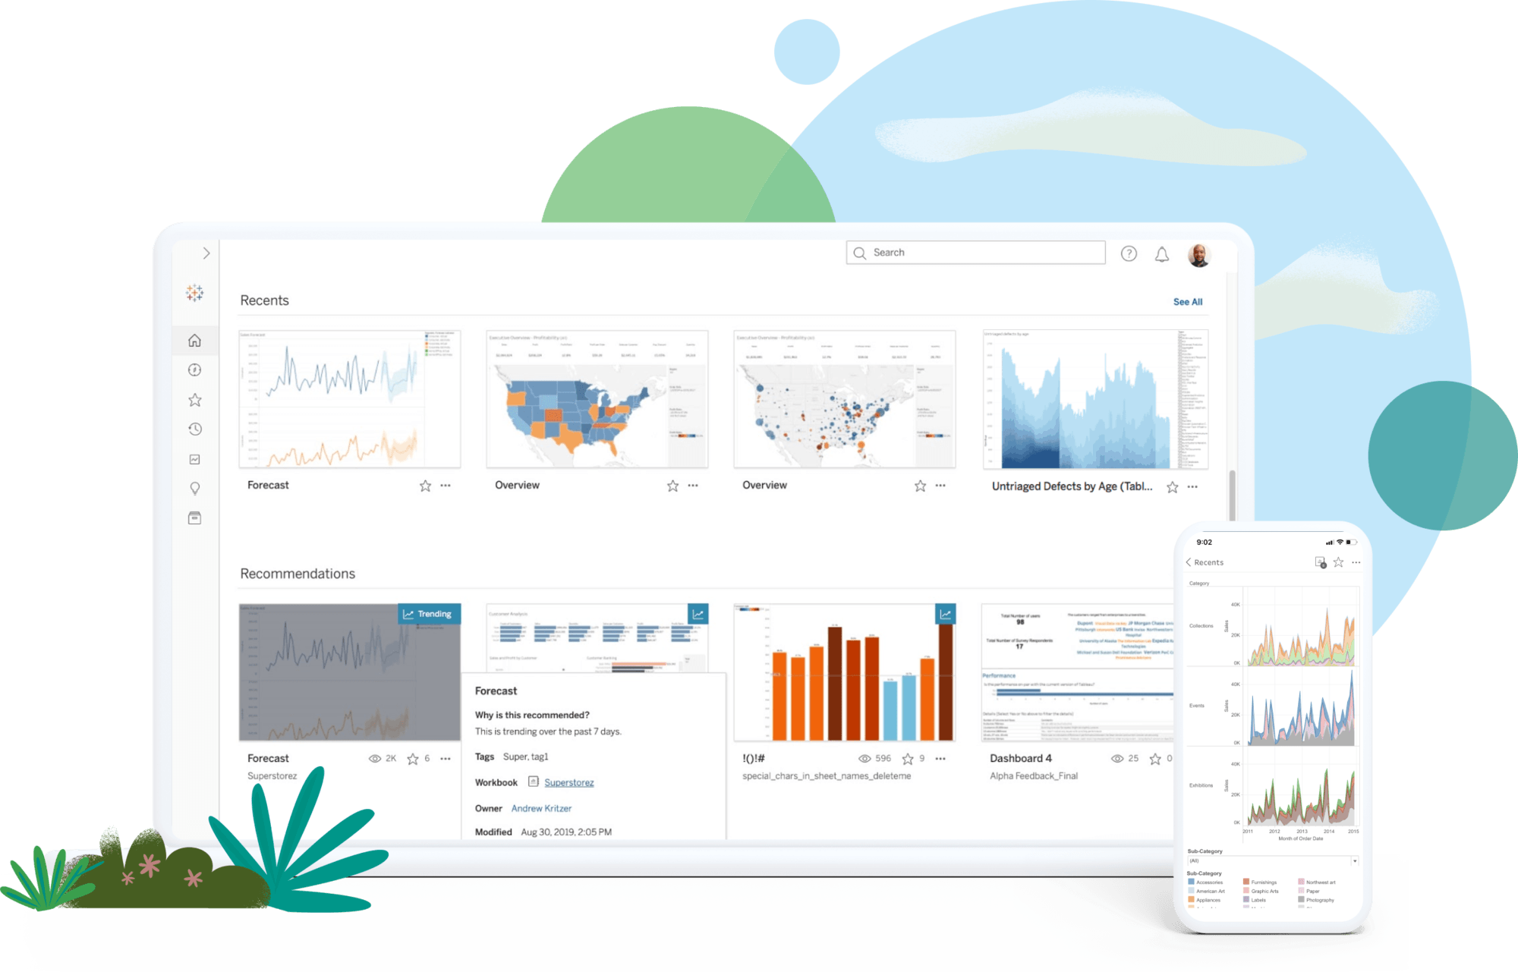
Process of making Tableau dashboard
Step 1: Connect to your data.
Step 2: Drag and drop to take a first look.
Step 4: Explore your data geographically.
Step 6: Build a dashboard to show your insights.
Step 7: Build a story to present.
Step 8: Share your findings with others.

Slide 8
Types of Tableau
1) Tableau Desktop
2) Tableau Public
3) Tableau Online
4) Tableau Server and Tableau Reader.

Slide 9
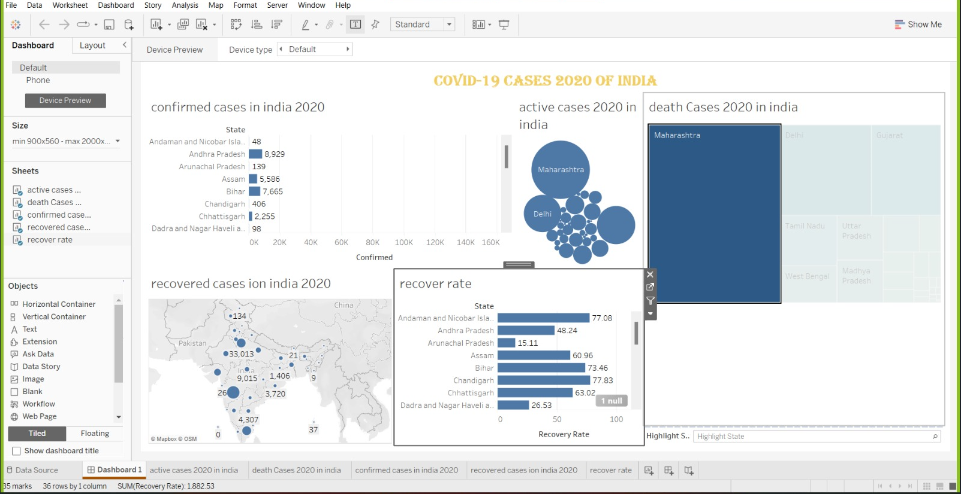
Tableau dashboard

Slide 10


